Slide 1
Coastal Harvest Mobile Food Bank
Angela Burton, Executive Director

Slide 2
Why we got started
Communities in our service area not able to sustain food pantries
The need continued to grow, people were hungry
The CH Mobile Food Bank was created to fill a void
We now work with each community individually to meet the need

Slide 3
Our Mobile Food Bank
Cooler
Freezer
Mobile Boxes
Mobile Boxes
Mobile Boxes
Mobile Boxes
Paper Product
Generator
Produce
Produce
Cooler
Freezer
Freezer
Conveyer

Slide 5
How does it work
General operations
Monthly distributions
Mobile Boxes
150 boxes
Set up/Sign in
Boxes distributed by number in each family

Slide 6
How many people
How many people to run
1 CDL Class A Driver
1 Mobile Food Bank Manager
1 Volunteer at Sign In
1 Volunteer Assisting with boxes

Slide 7
How many hours
Roughly 12 hours per location
We operate 2 sites, so 24 hours per month
3 different staff needed
1 Driver
1 Warehouse
1 Mobile Food Bank Manager
Why so many?
Allocations
Picking product
Building Mobile boxes
Prep
Paperwork
Actual Mobile day

Slide 8
Mobile Boxes
TEFAP
Northwest Harvest
Coastal Harvest
Purchased

Slide 9
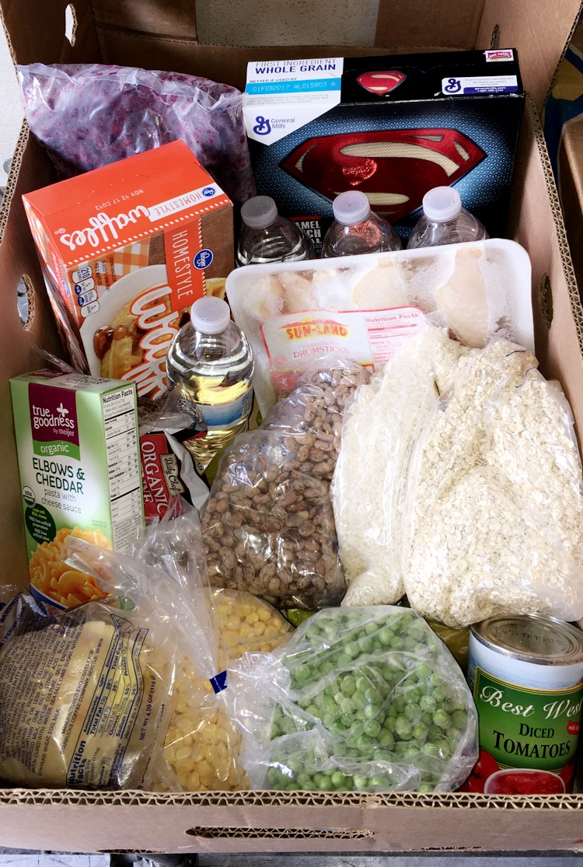
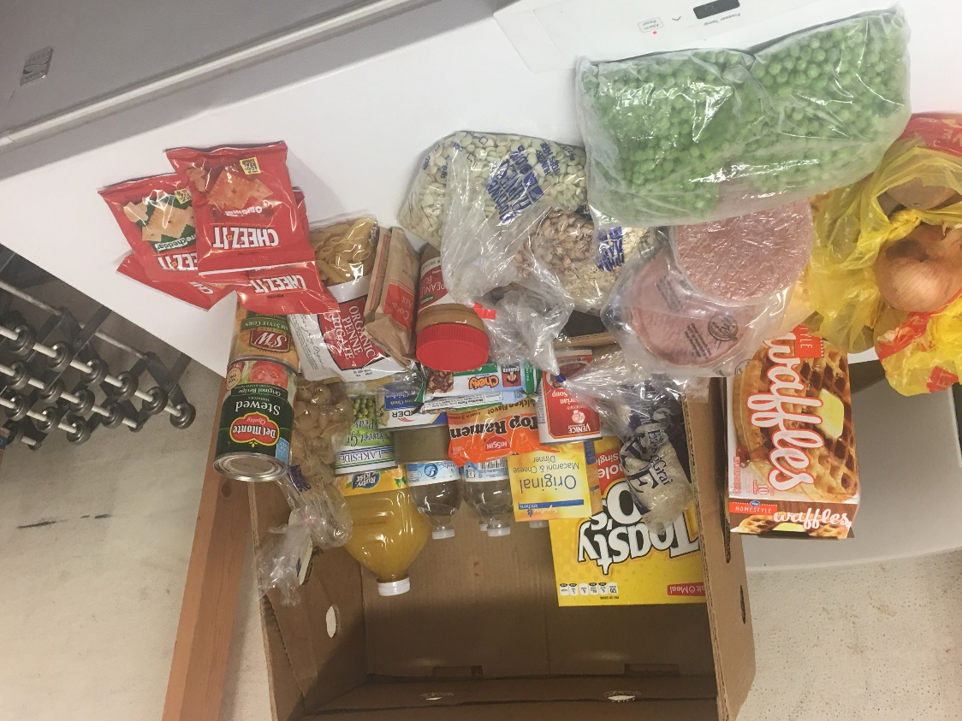
Mobile Boxes
Protein
Grains
Fruits
Vegetables
Peanut Butter
Water

Slide 10
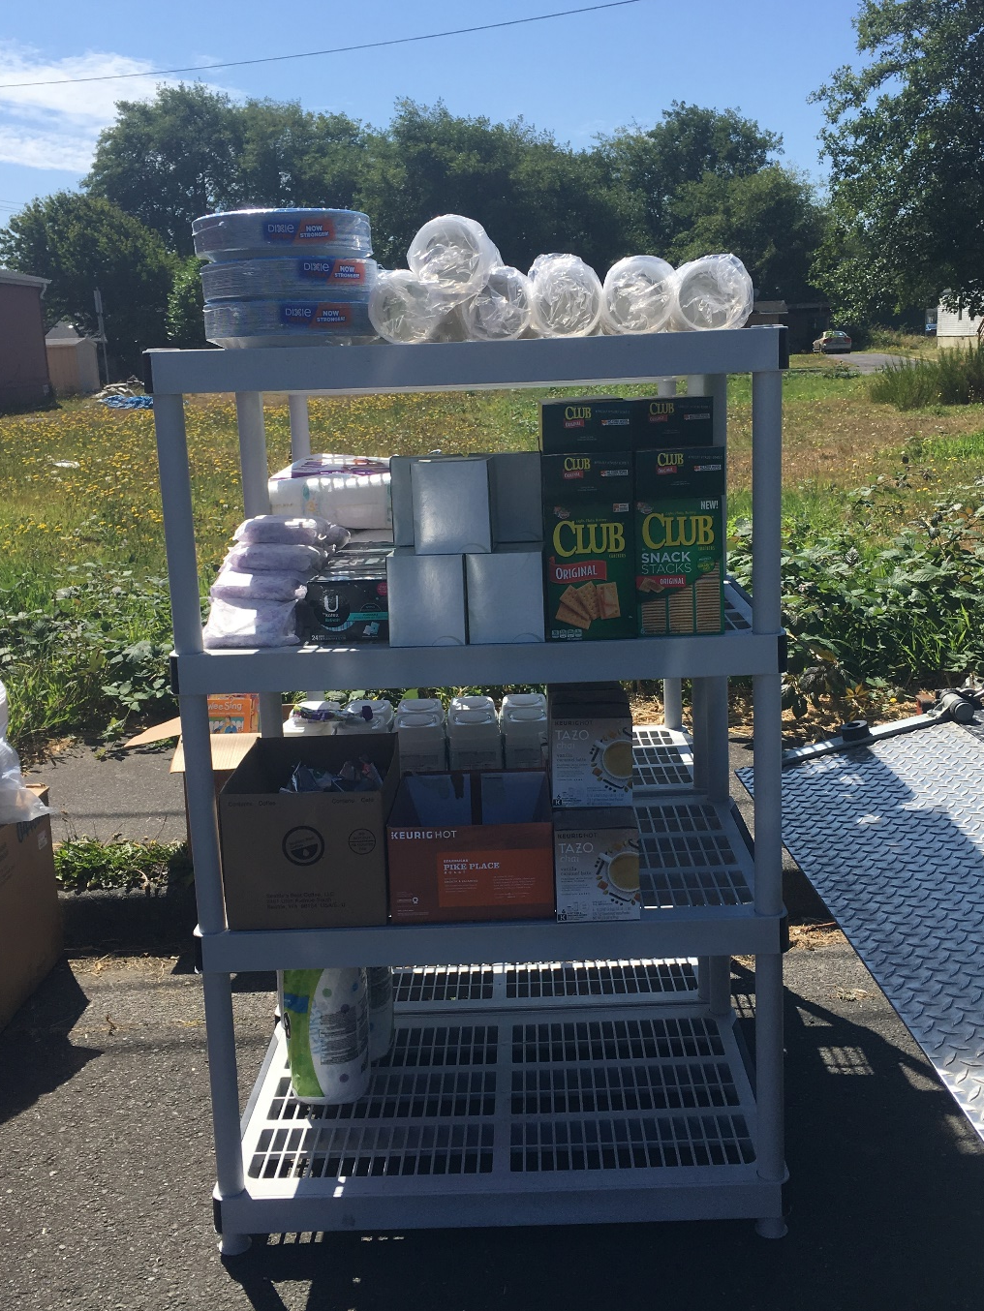
Extra, Extra!

Slide 11
How much does it cost

Slide 12
Cost Breakdown

Slide 13
How are we funded
Grants ($10,000)
Seabrook Community Foundation
Vacation destination
A percentage of all home purchased to fund
Donations ($3,000)
Many individuals donate specifically to Mobile Food Bank
Fundraising ($5,000)
Corporate/Donor Matching ($5,000)
General Operations
For any additional funding needed

